Slide 1
Intro
Project title and team
Value proposition
Problem/solution overview
Outline of talk
Sketching explorations
Overview images of 10-15 concept sketches – no need to talk in detail about these while presenting, just meant to capture your process
2 further fleshed out realizations
Selected interface & rationale
Present the most relevant pros and cons and have the full lists in the appendix
Relevant data, constraints of the platform, and findings that shaped your decision
Why is the design you chose superior?
Low-fi prototype construction
a. How the prototype was built and operated; its features and interactions
Low-fi prototype: 3 task flows
Simple, moderate, and complex
Complete and clear with use of captions, labels, transitions, and annotations as required (can use a different color if helpful)
Testing methodology
Participants: demographics, recruitment, compensation
Environment and apparatus
Procedure: team member roles, description of process
Usability goals and key measurements
Testing results
Process data (what’s happening in the big picture)
Bottom-line data (usability goal key measurements)
Other relevant observations
How well did you achieve your usability goals based on the key measurements?
Discussion
What are the implications of your findings?
Based on the results, how will you change your design?
Was there anything that the testing couldn’t reveal?
Appendix
Full list of pros and cons for selected interface rationale
Link to the low-fi prototype on Marvel POP, etc. (if applicable)
Any preparation you did for the testing (e.g., script)
Organized log of critical incidents from testing

Slide 2



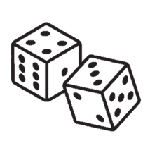
Turno
LOW-FIDELITY
PROTOTYPING
Break Cycles,
Build Habits
ASSIGNMENT 5
CECILIA, MALINA, NAZANIN, PEDRO

Slide 3
1 About us
2 Sketching
3 Interface + Rationale
4 Low-fi Prototyping
5 Testing
6 Discussion
AGENDA

Slide 4
Problem
Solution
There are daily obstacles preventing busy individuals from living an active lifestyle and accomplishing their goals — big or small.
Turno allows users to input their activity goals, tasks to accomplish, & habits to build. Users roll a dice every morning to determine which of those tasks they should tackle that day, allowing them to overcome decision paralysis & establish long term habits.

Slide 5
Turno
Break Cycles,
Build Habits
From the Portuguese word for shift, or round, and the idea of it being your turn. Turno. Your turn to roll the die and take agency of your life.

Slide 6
value proposition
Game your tasks: Make every chore feel like a turn, not a toil.
Turno’s value proposition embodies the problem we seek to solve & the solution we provide for our users
Notes:
Wanted to make it more unique to our solution
gamifying and randomizing people’s daily tasks to feel like their turn in a game rather than a chore.

Slide 7
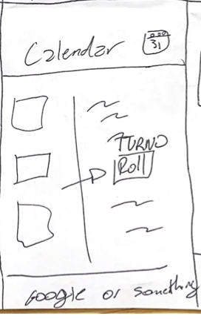
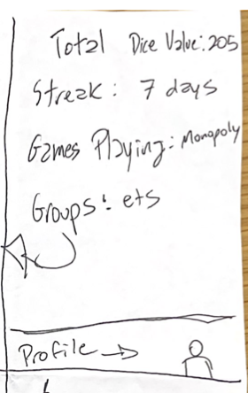
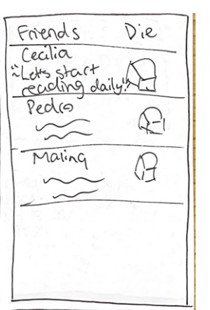
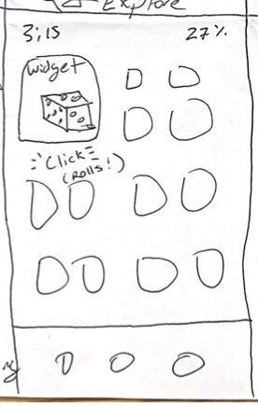
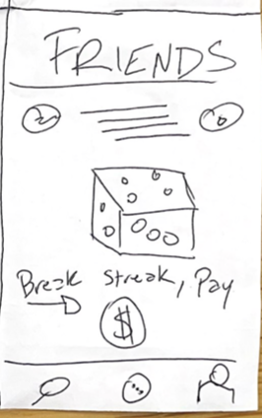
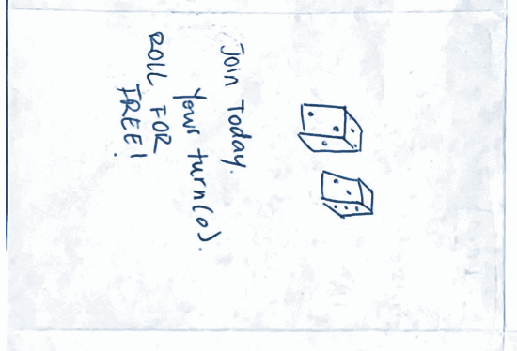
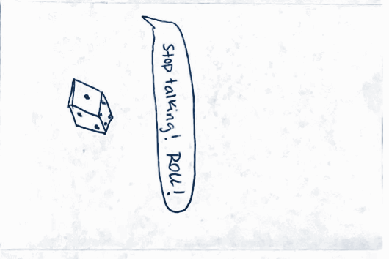
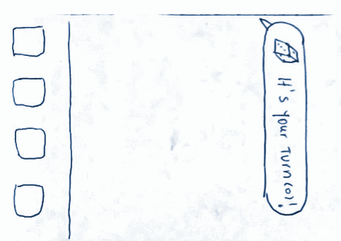
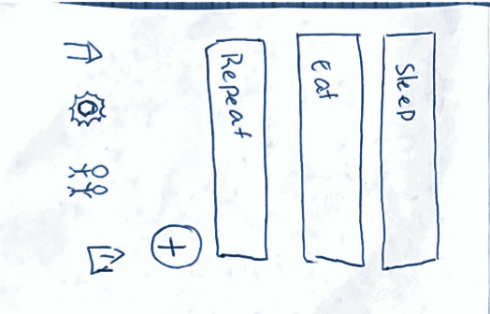
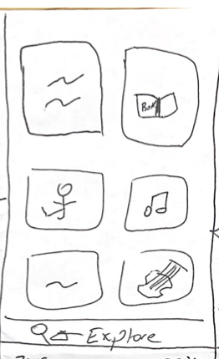
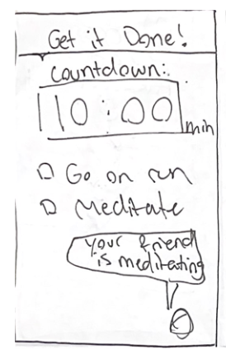
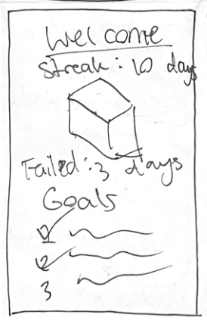
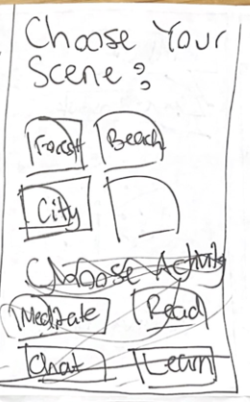
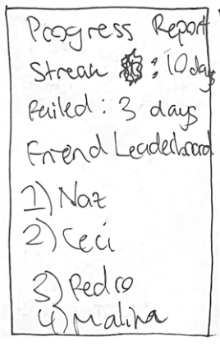
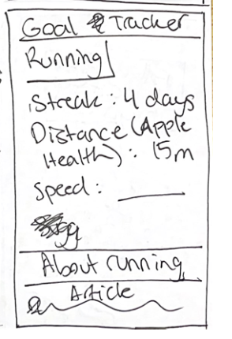
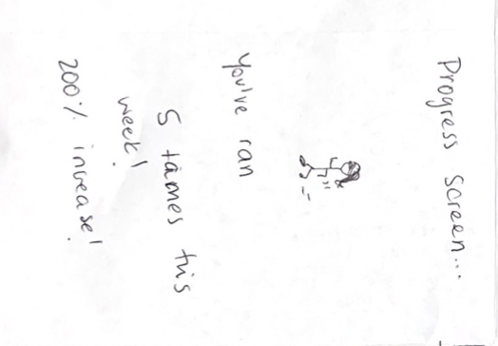
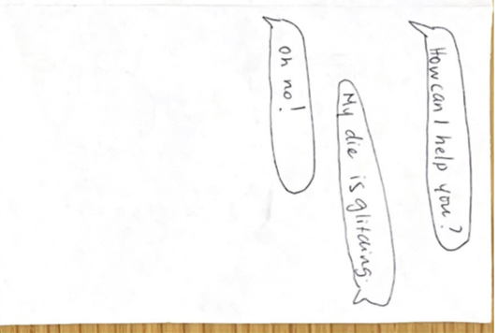
Realization 1: Mobile
Notes:
concept sketches - skim

Slide 8
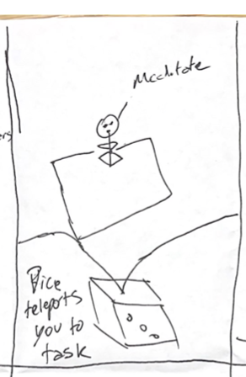
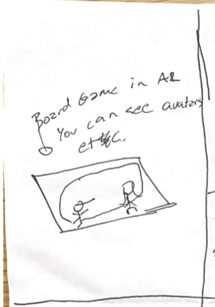
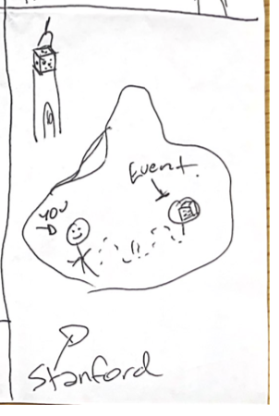
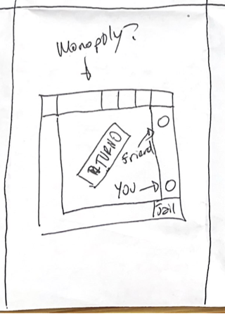
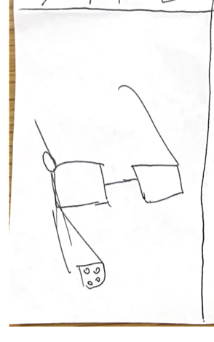
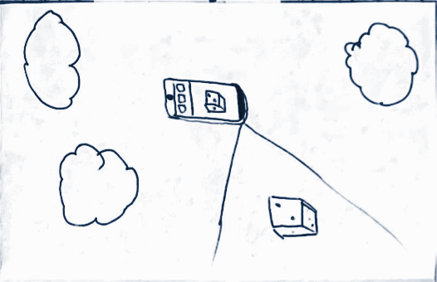
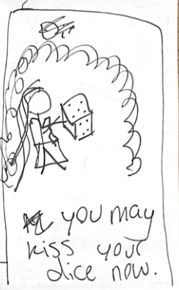
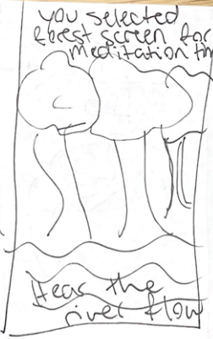
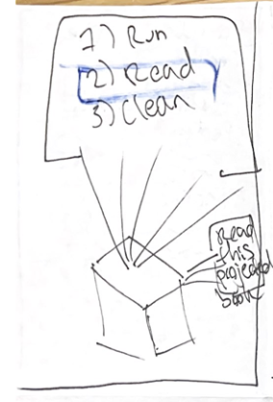
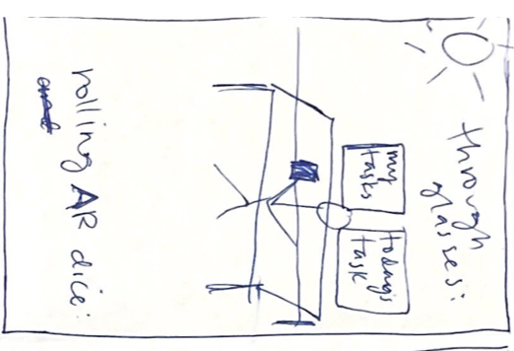
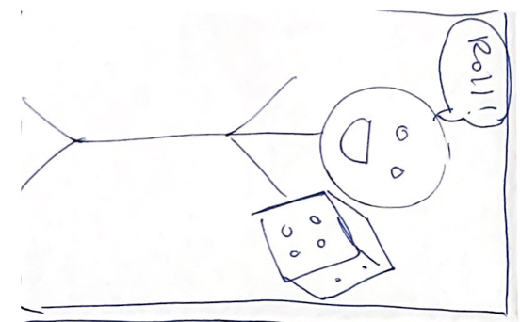
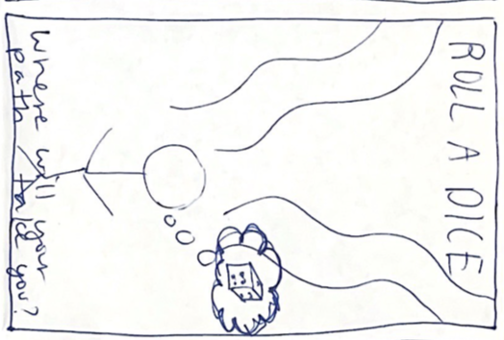
Realization 2: AR

Slide 9
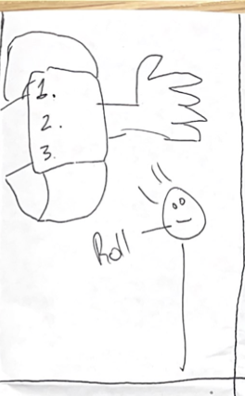
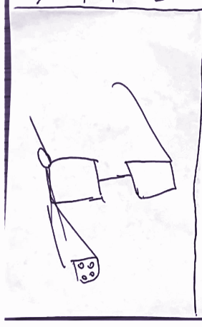
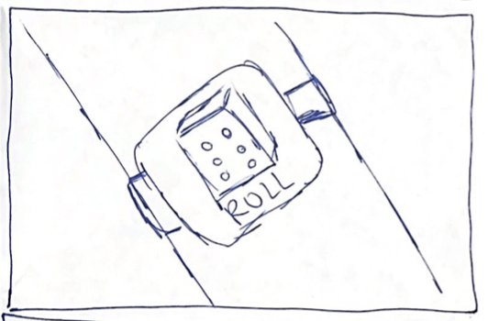
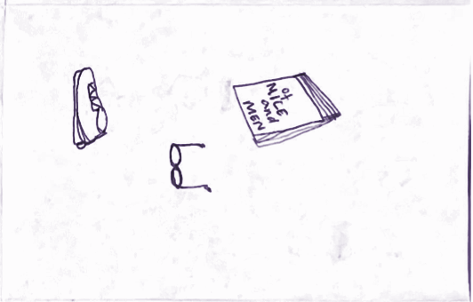
Realization 3: Wearables

Slide 10
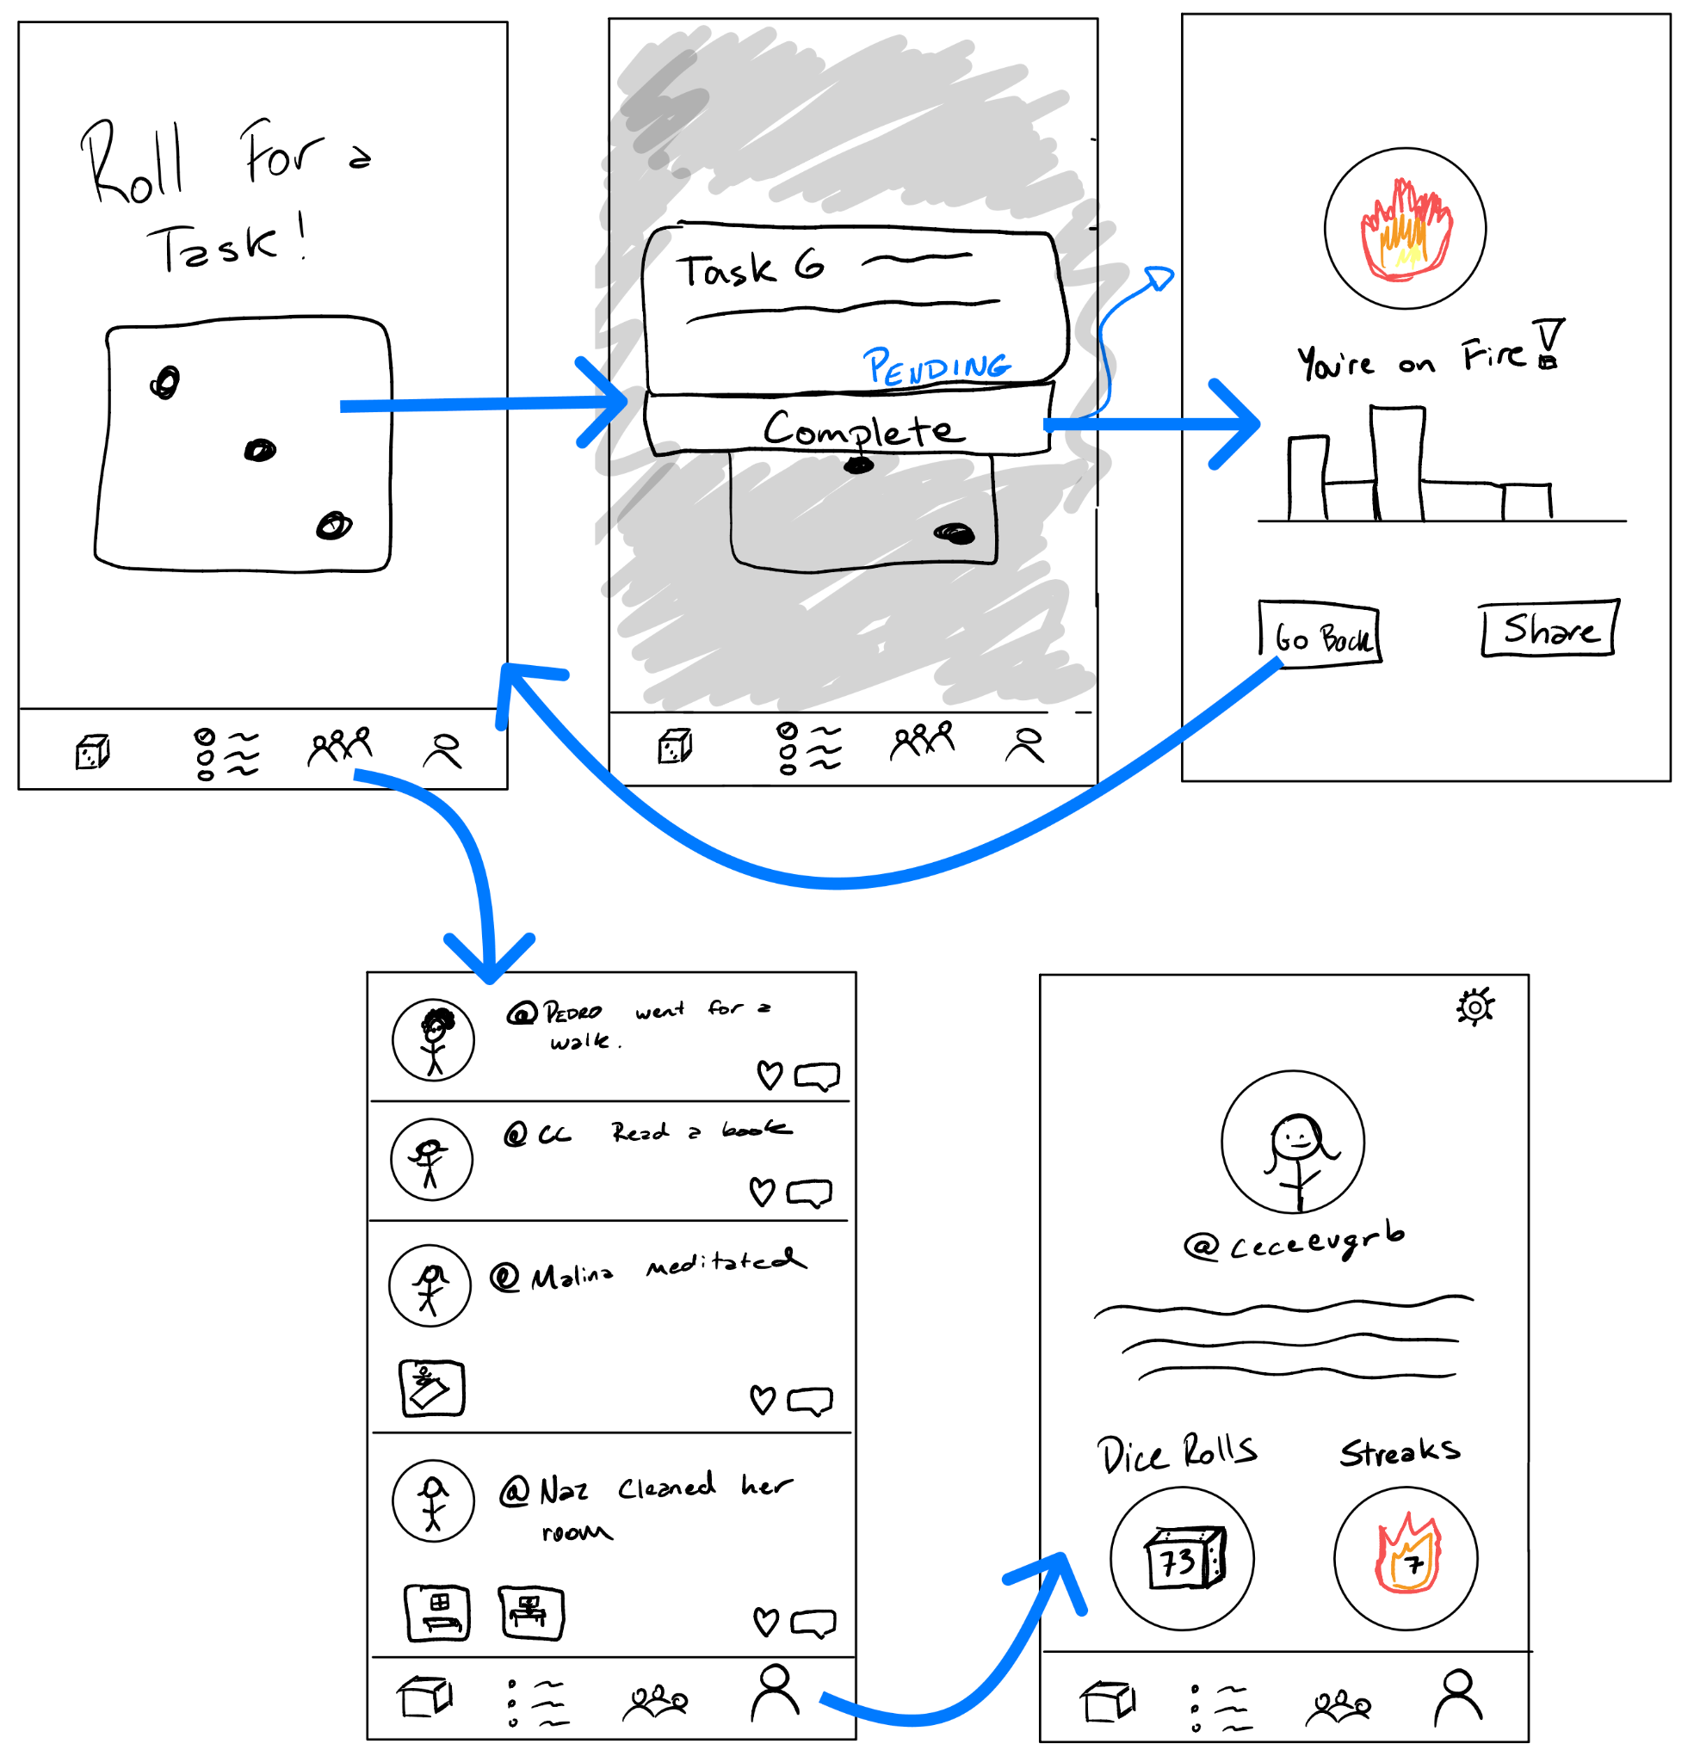
Mobile, Expanded
Notes:
Wanted to explore and expand upon Mobile and AR - getting a sense of what pages we would want
Explain why we fleshed out these realizations

Slide 11
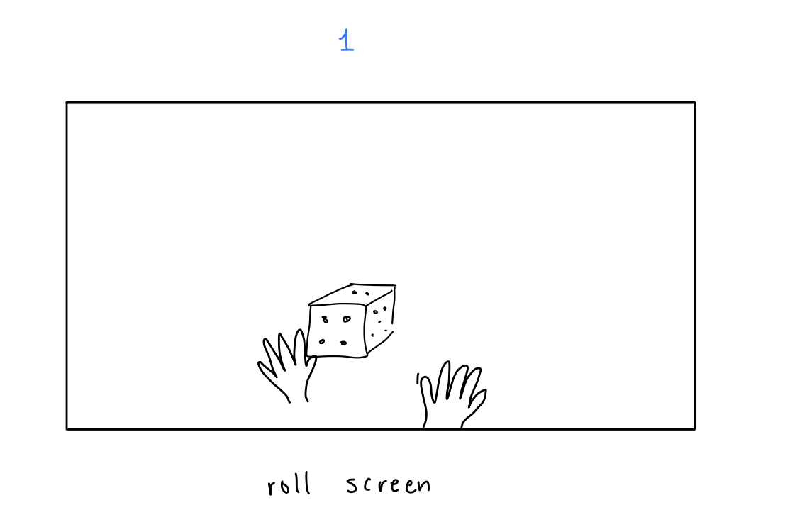
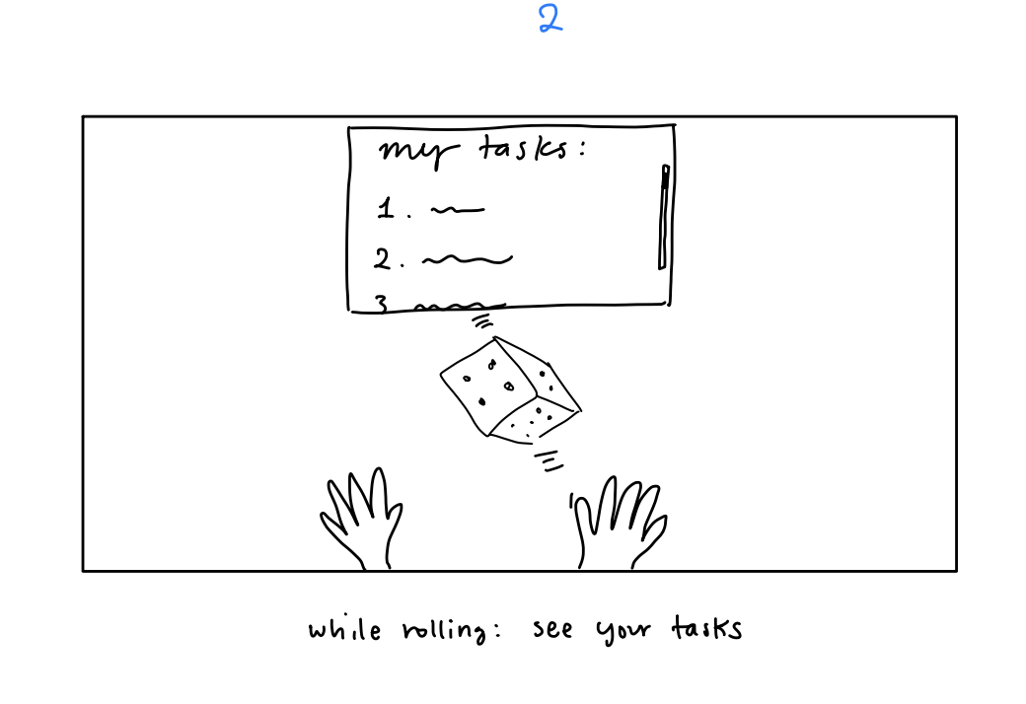
AR, Expanded

Slide 12
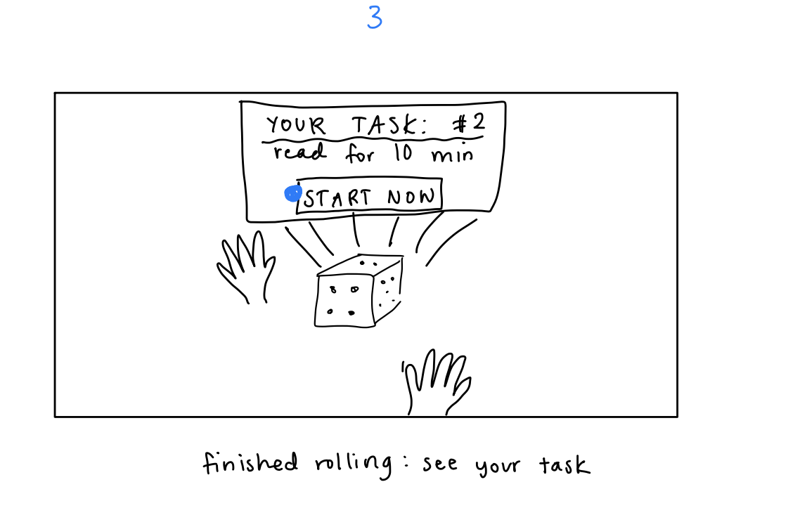
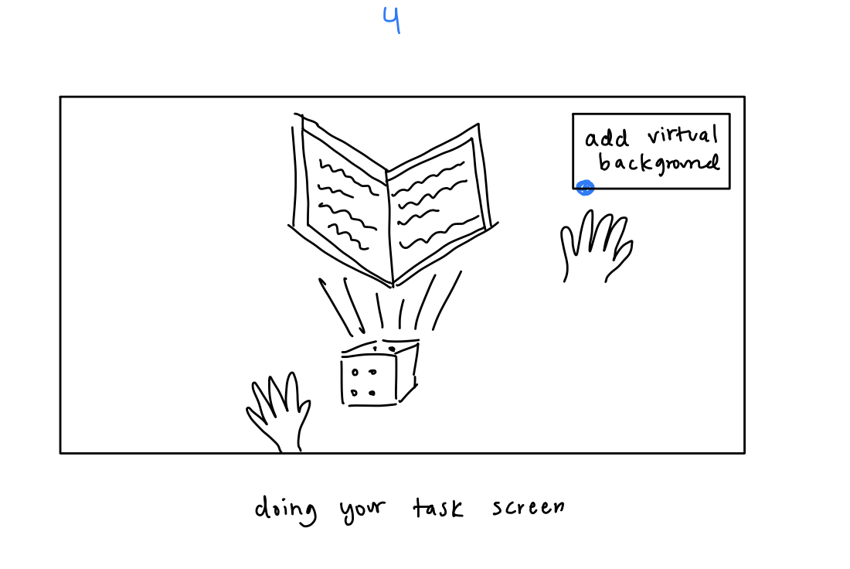
AR, Expanded

Slide 13
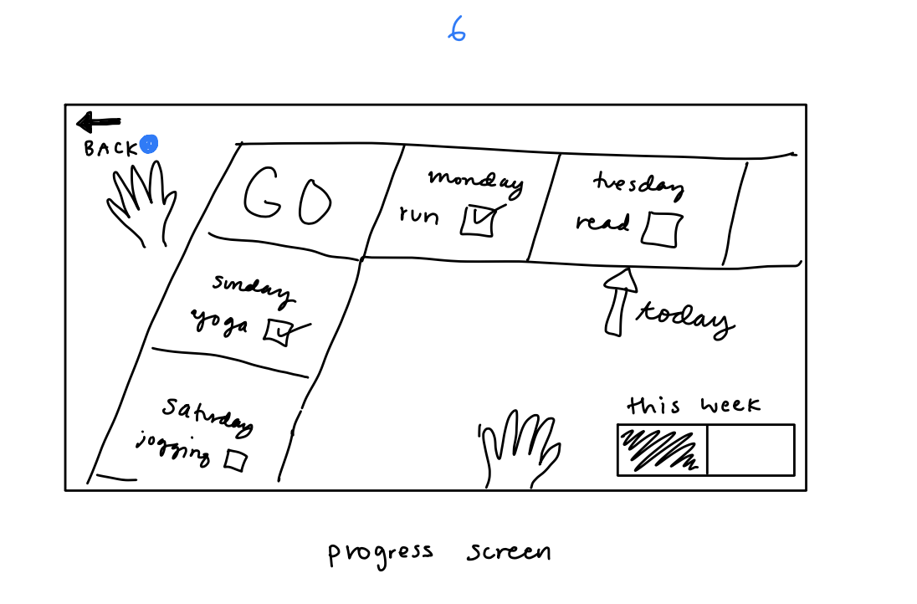
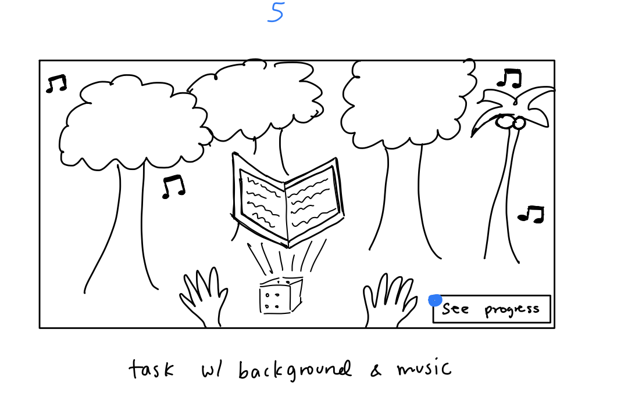
AR, Expanded

Slide 14


AR: Pros x Cons
Interactibility: Extremely interactive and exciting | Relevance: AR is meant to add to physical world around you, but our solution doesn’t require that.
Realism: Rolling a dice can feel very real when it’s in AR | Feasibility: An AR solution may require more money and/or require additional hardware
Physical: AR requires users to do physical movement to use the app, which ties back to our domain of encouraging (physical) activity | Convenience: Less likely to attract users since most people don’t use AR apps in their day-to-day life, and difficult to integrate into daily daily life flows.

Slide 15
Selected Interface
Mobile: Pros x Cons
Ease-of-use: Simple usage (tap the phone surface). Low barriers to entry due to intuitive usage. | Design Limitations and Device Compatibility: Design may not flow in different operating systems. A mobile UI design will not fit well into an ipad or laptop interface.
Convenient: Integrates into the user’s daily workflows/lives. They use their phone daily. | Cluttered Tool: The mobile phone is often cluttered with other apps and tools which can serve as distractions (e.g. user can be distracted by a notification while using our app)
Accessibility: Easily accessible (can be used in private, public, and in a variety of settings). Mobile apps are easily accessible. | Low Engagement: Less engaging and exciting than AR.

Slide 16
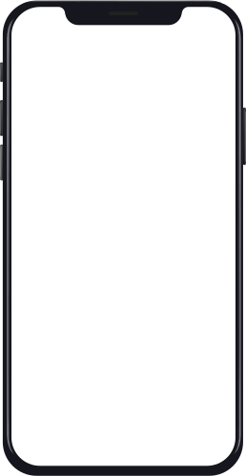
Selected Interface & Rationale
Findings - why a mobile app?
Easy to access
Intuitive to use
Enables a wider reach
Ensures larger user base
Turno
Data
81.6% mobile penetration rates in the US.
Only “1% of retailers use AR”
More than 50% of retailers are “not prepared” to launch, support, or produce AR
Only “26% of smartphones are AR kit or AR core compatible”
Break Cycles,
Build Habits
Notes:
Mobile is portable, AR is unreasonable and expensive
Why is the design you chose superior
https://www.threekit.com/20-augmented-reality-statistics-you-should-know-in-2020

Slide 17
Lo Fi Prototype Construction

Slide 18
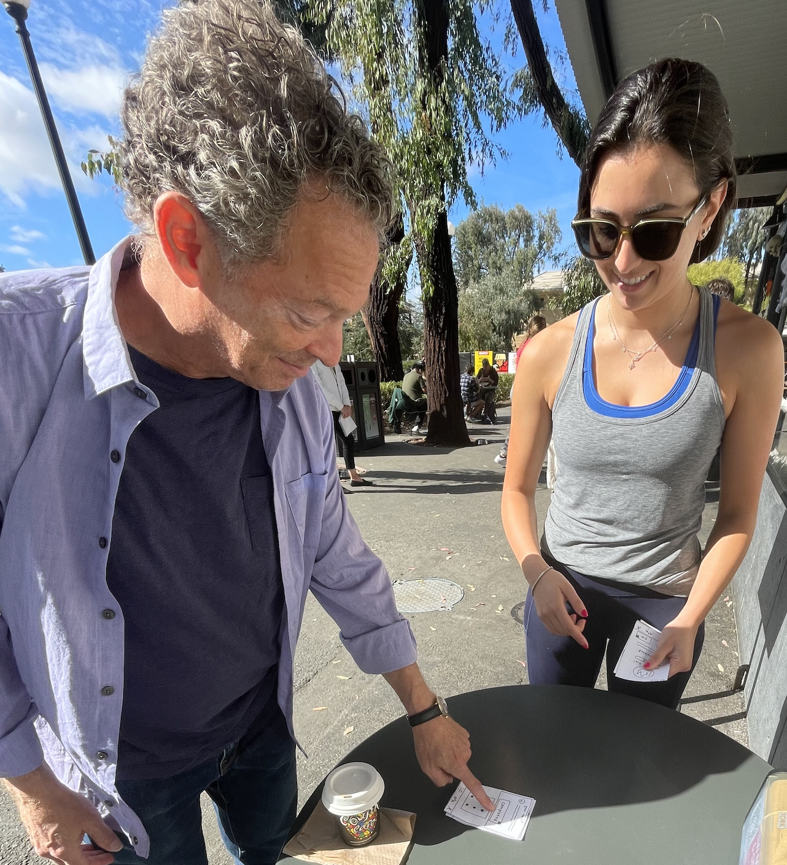
Prototype Construction
Prototype drawn as a group with iPad & printed on paper
Pages implemented: home page & other pages needed for our task flows (eg: tasks page, friends page)
Features include sharing with friends & creating group tasks
Used paper checkboxes & pop-ups inspired by Snyder reading
Manually responded to user actions by placing our paper prototypes
Notes:
Low-fi prototype construction a. How the prototype was built and operated; its features and interactions

Slide 19
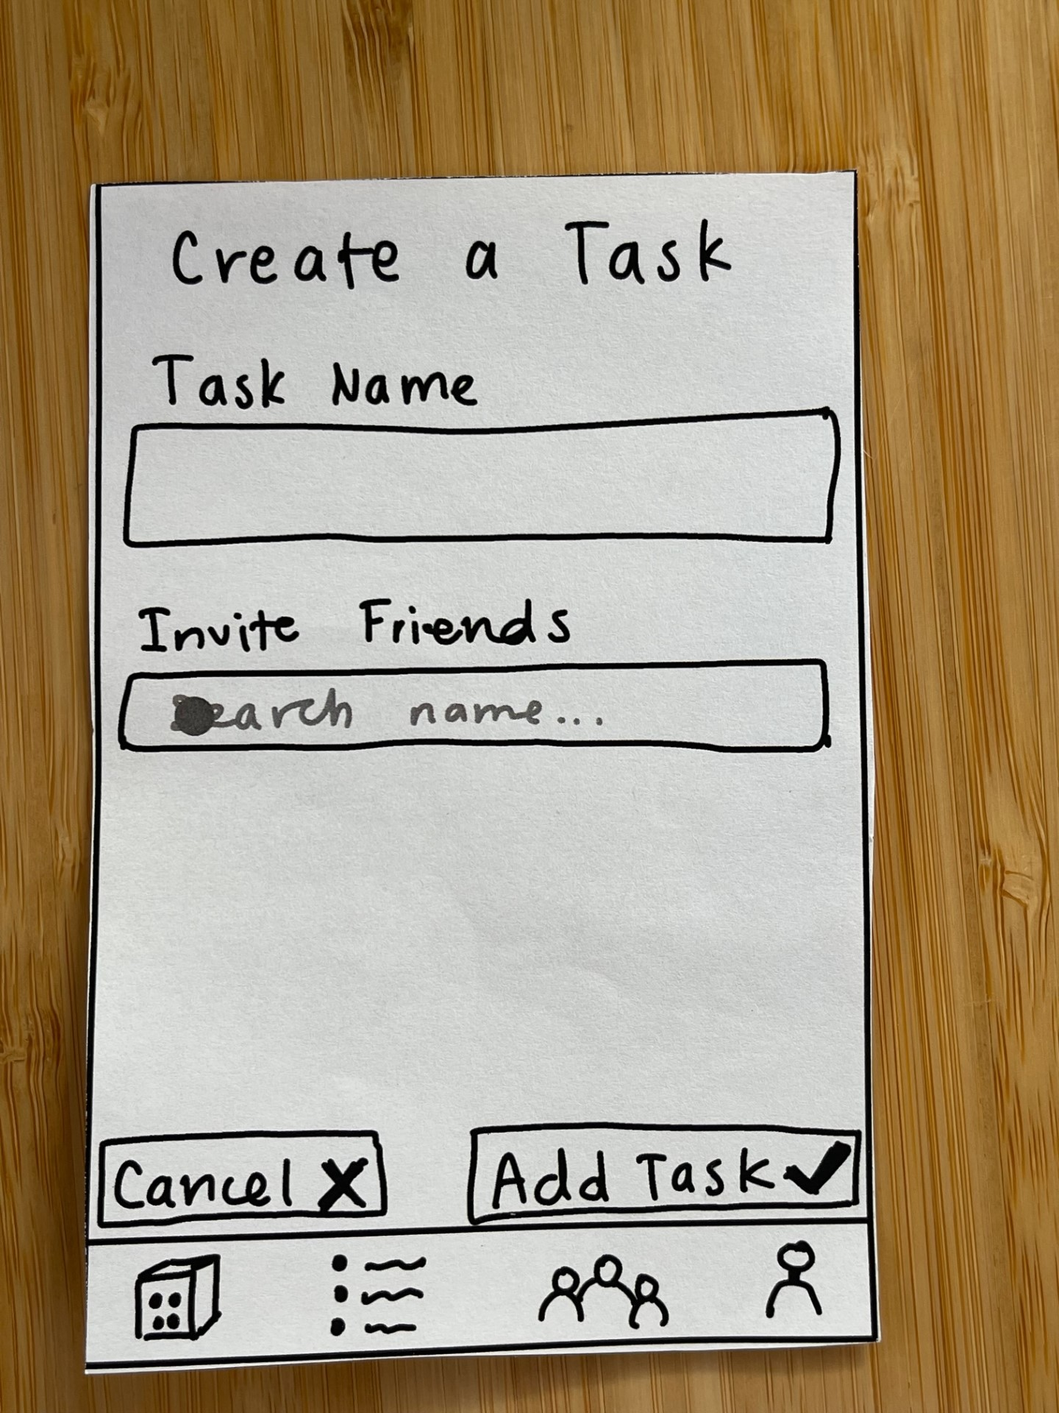
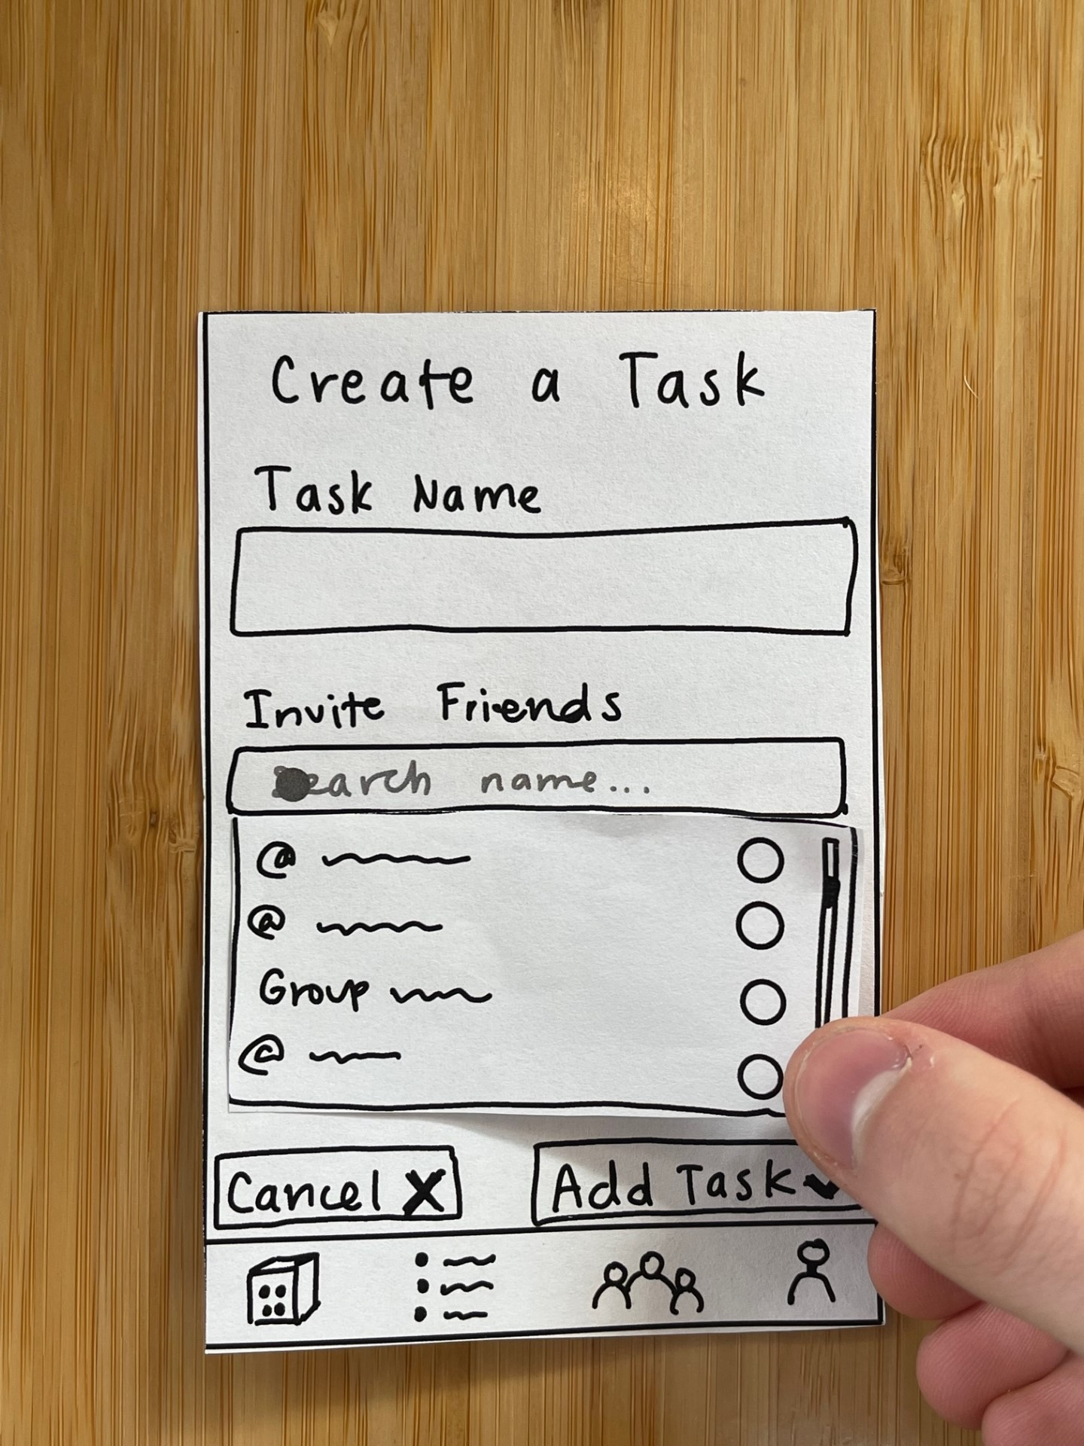
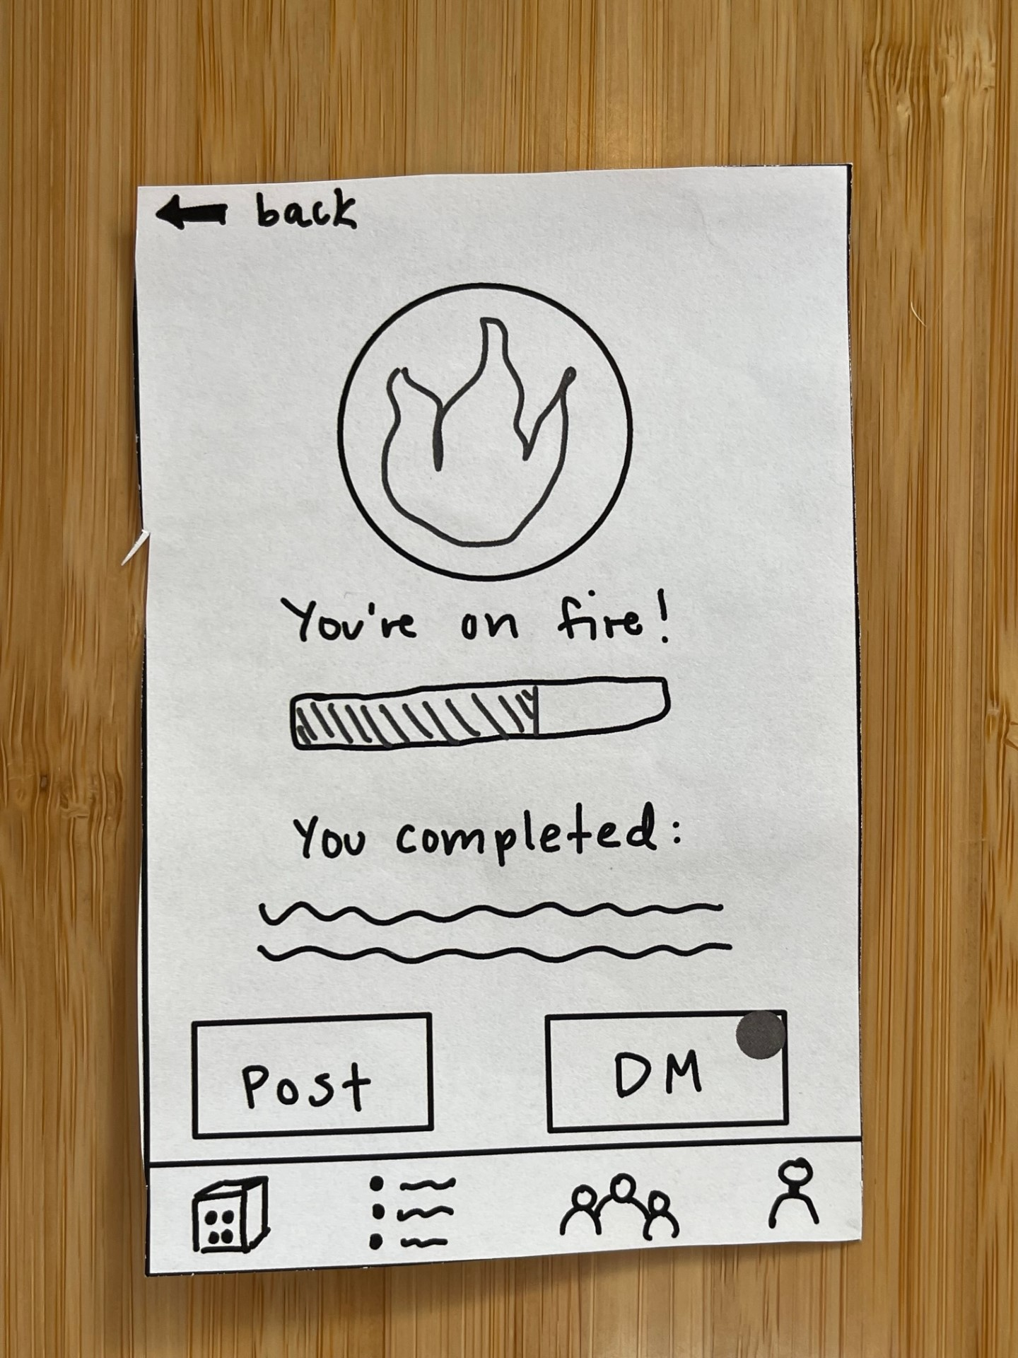
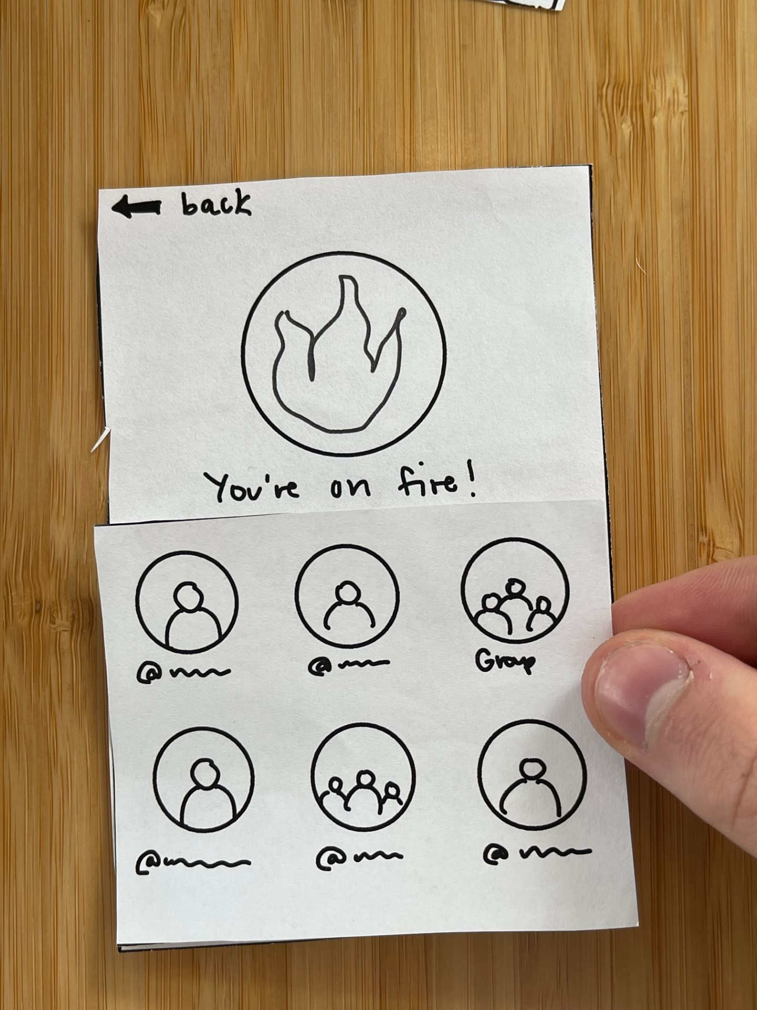
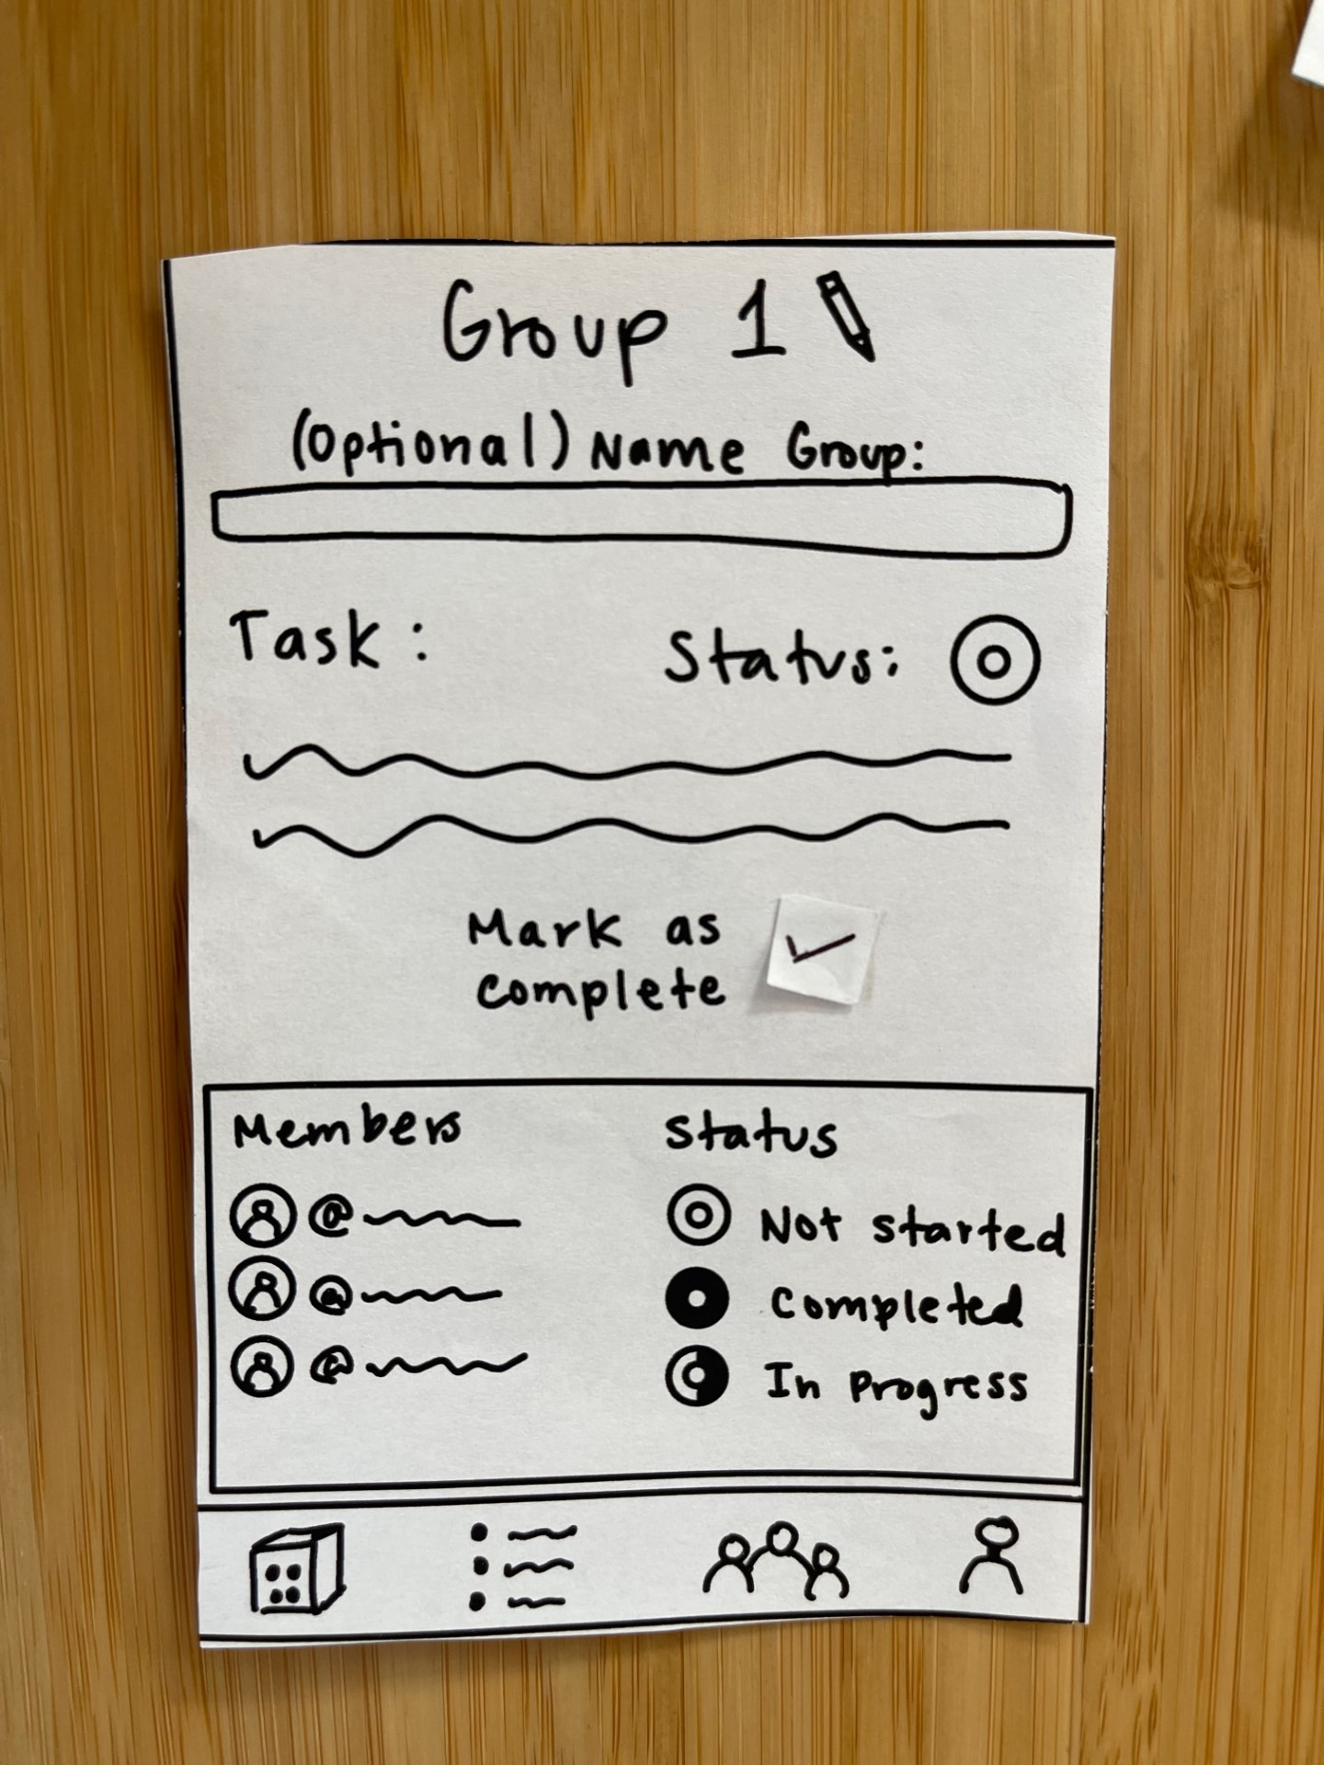
Snyder’s Paper Prototype Methods

Slide 20

3 task flows
simple
moderate
complex
1a Complete a task!
1b Share the news with friends!
2 Write out your task list!
3 Complete a task with friends!

Slide 21
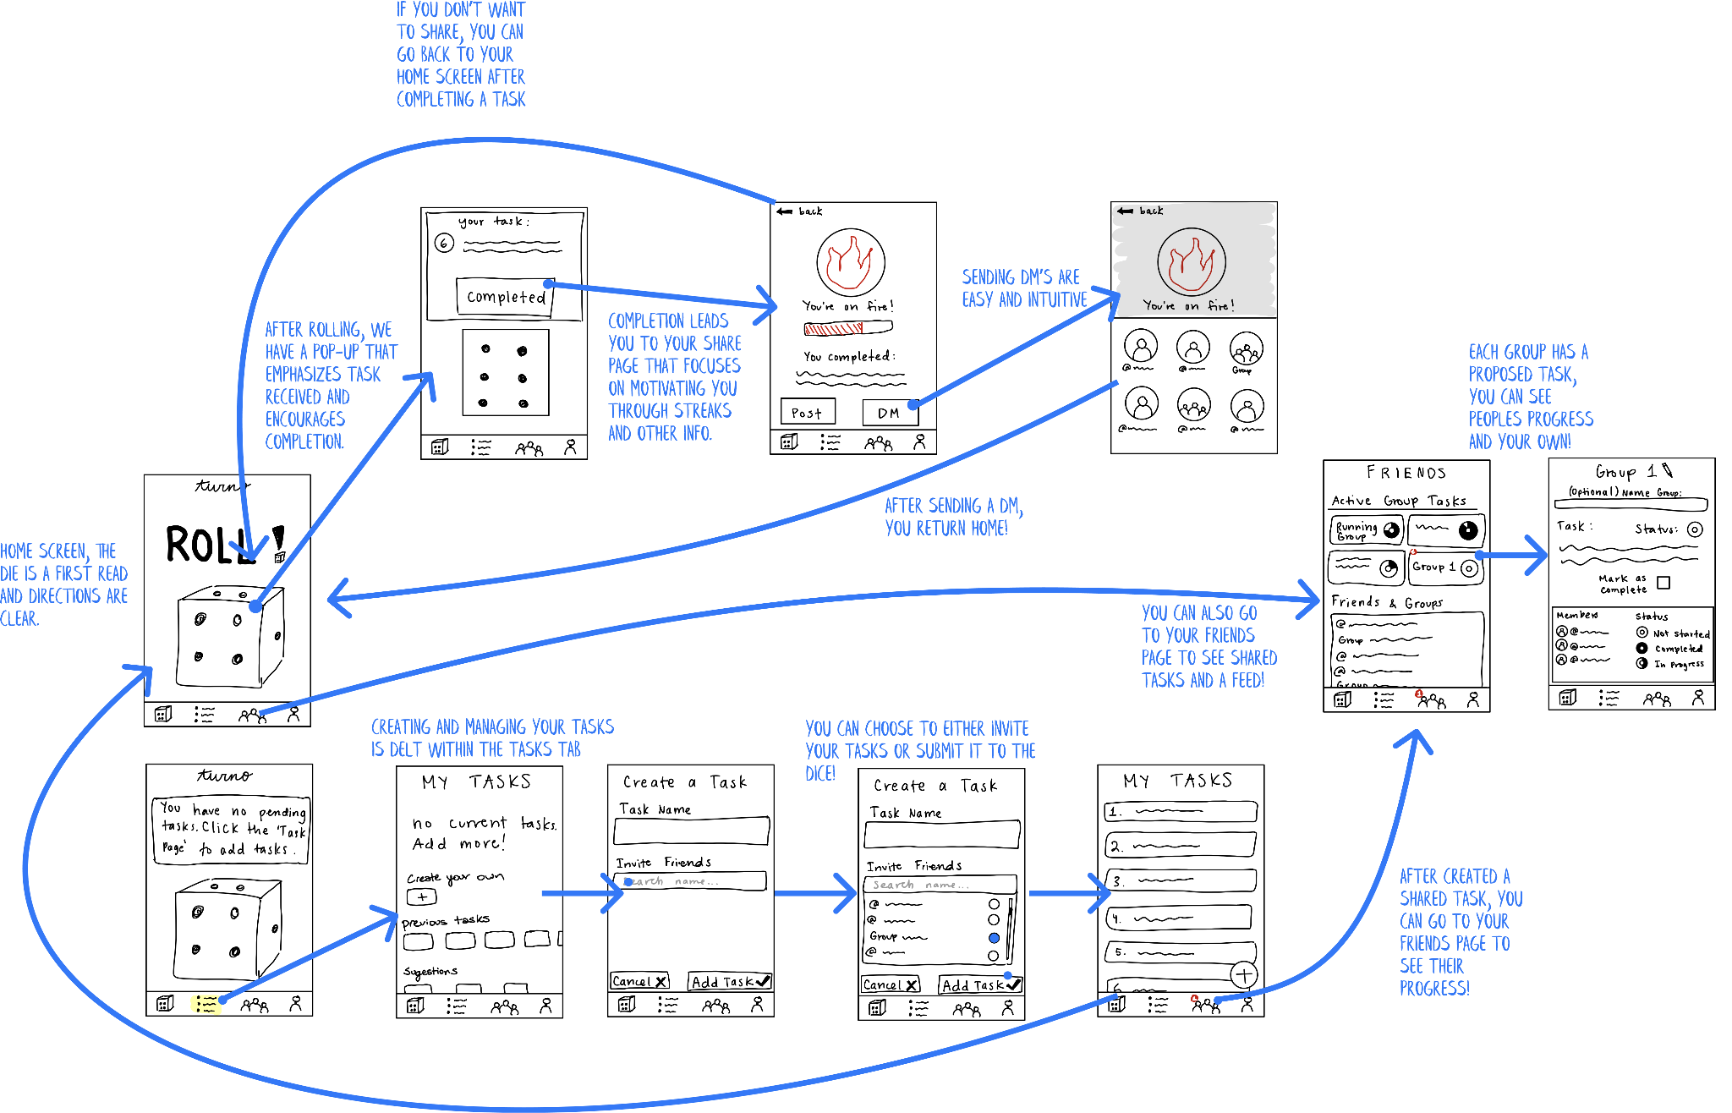
Full Storyboard
Notes:
Skim over this

Slide 22



3
simple
Complete a task
Share the news with friends
Notes:
Explain why we grouped these together as simple tasks - as sharing news with friends requires you to complete a task in the first place, but recognized that these are separate

Slide 23
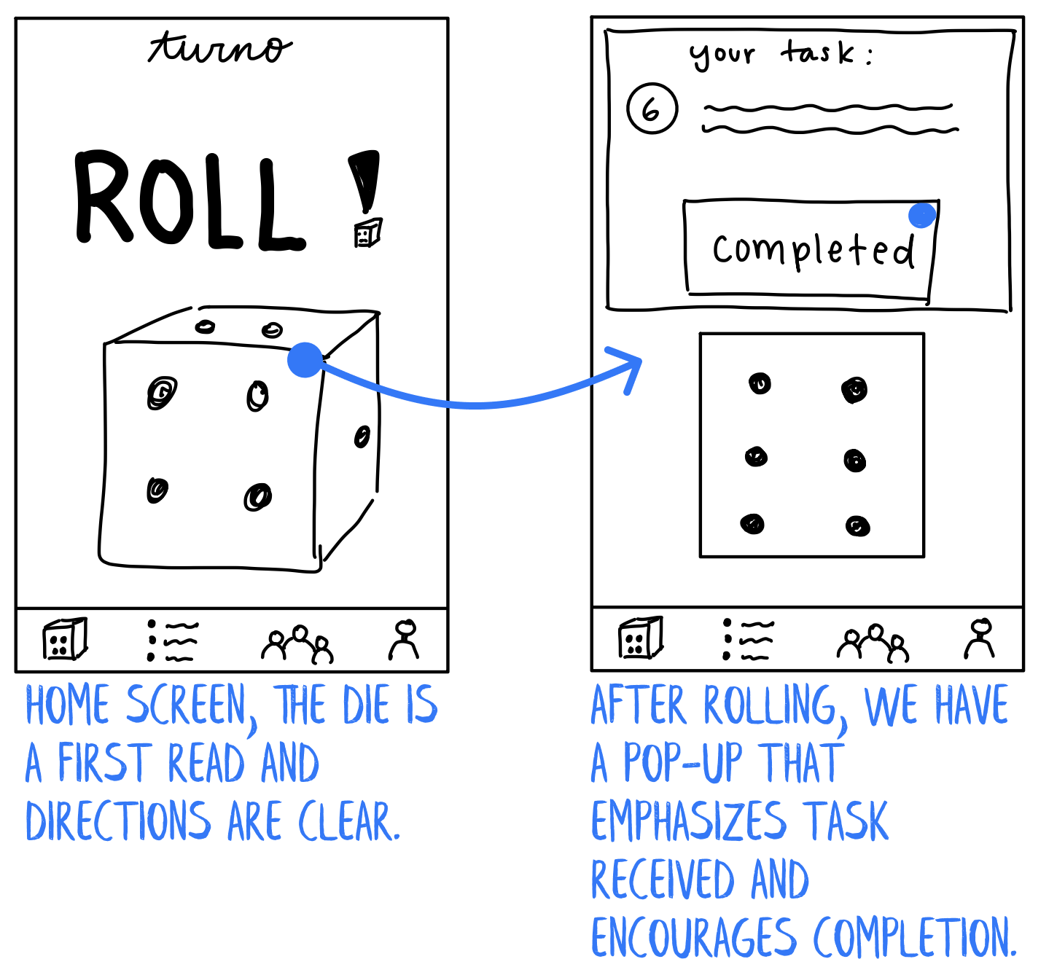
Complete a Task
Notes:
The simple tasks are what you do most frequently, and in this case it’s just rolling a die to complete the task

Slide 24

Share the news with friends
Notes:
From there, you can share the news with friends

Slide 25

3
moderate
Write out your task list
Notes:
Rationale for moderate is that it requires a few more screens and effort and decisions, but is still pretty core to the frequency of use of our app, but less frequency than the simple tasks.

Slide 26

Write out your task list

Slide 27

3
complex
Complete a task with friends
Notes:
This is complex because we assumed that it would be the least frequent

Slide 28

Complete a task with friends

Slide 29
Testing Procedure

Slide 30




Testing Methodology
Participants
Sought participants of different jobs & ages
No compensation; asked for a few minutes of their time
Environment
Various campus locations
Tested at participants’ tables
Made them feel comfortable in their own environment
Told them background of class & project
Prepared a script (see appendix): explained 1 task + had them complete without clarification. Repeated for subsequent tasks
Answered their Qs only after first prompting them to try without our help
Asked users to reflect on which functions were intuitive and vice versa
Procedure
Member Roles
Greeter: Malina Tester: Nazanin Notetakers: Pedro & Cecilia
Notes:
after finishing each task, we asked our users to reflect on the functionality of the app: which functions were clear & intuitive? which ones were unclear, and what made them so?

Slide 31
Usability Goals and Metrics
Pleasing (high user satisfaction)
Process Data
Time to value (how long it takes for the user to recognize the value of the app)
Task completion rates
Number of tasks / interaction with friends
Posting rates
Bottom-Line Data
Adoption: DAU, WAU
Satisfaction: NPS (through ratings/reviews occasionally)
Stickiness: Retention (4-week, 8-week)
Efficient (perform tasks quickly)
Process Data
How many of the different features are used/different tasks completed
Bottom-Line Data
Number of service tickets / customer support tickets
Time spent creating task list
Time spent completing tasks
Time spent rolling dice
Time spent when sharing a task completion
Notes:
leo testing:
1st goal: even in 2nd task, people tried to add friends since it was center frame.
wouldn’t scroll down it didn’t feel intuitive. we don’t want people to have to scroll on our app too much.

Slide 32
Usability Goals and Metrics
🎯
Pleasing (high user satisfaction)
Task completion rate
NPS and how likely the user would be to recommend the app (1-10)
Efficient (perform tasks quickly)
Number of service tickets, measured as number of “mis-clicks” or questions asked
🔑
🔑
🎯
🔑
🔑
= KEY METRIC
🎯
= USABILITY GOAL

Slide 33




Participants
Guillermo
Construction Worker
Glen
Comparative Literature Professor
Leo
Owner of an Açaí stand
John
Elementary school teacher

Slide 34
Testing Results

Slide 35
Key Metrics Results
Process Data
All participants were confused by the meaning of creating tasks with friends and navigating group task progress.
Most participants completed all the tasks.
Some participants found the home page difficult to understand, and didn’t realize the dice was meant to give them a task.

Slide 36
Key Metrics Results
Process Data
2 participants felt they were pressured into sharing progress with friends.
2 participants wanted to see more progress tracking than the congratulations page.
1 participant wanted to view a feed of tasks he had completed.

Slide 37



Key Metrics Results
Bottom-Line Data:
Few participants said they would recommend the app to friends (Average NPS score was 5).
We measured 4 mis-clicks, where the user clicked on the wrong button than they intended to.
In total, users asked clarification questions 6 times, which we treat as service-tickets.

Slide 38
Other Observations
Tasks 1a and 1b were easy for users to complete and required minimal taps.
Task 2 was straightforward but users showed hesitancy.
Task 3 was most confusing for users. None of them were able to complete it on their own.
Some usability goals were achieved well… while others were not.
Notes:
Some usability goals were achieved well:
Other usability goals were not:

Slide 39




Implications
Habit-building users don’t think a social feature is necessary for engagement.
Brainstorming is the hardest part of creating a list of tasks.
Icons and user guides are required for non-intuitive actions (e.g. rolling a dice to get a task).
Rewards and progress tracking were desired by users.
Notes:
habit-building users don’t care about the social feature
users struggled to create their own tasks

Slide 40
Design Changes Based on Results
Home page needs to be clearer with directions on using the die.
Reduce information on the friends page to make it intuitive.
Task page was simple but confusing. Make task status clear: completed, in progress, or not started.
Add a feature for ideas/inspiration on task generation to reduce brainstorming burden.
Add feed page and clear user progress reports.
Align user priorities to what is placed center frame (e.g. make the home button clear so users don’t feel overwhelmed by the share buttons.

Slide 41
Testing Couldn’t Reveal…
How completing group activities would look when all members have to actually coordinate and track progress.
How likely users would be to actually complete the task without the pressure of our testing set-up.
Notes:
hence we will address this

Slide 42
THANK YOU!

Slide 43
Appendix:

Slide 44
Mobile: Pros x Cons
Visual: Consistently visual interface | Design Limitations and Device Compatibility: Design may not flow in different operating systems. A mobile UI design will not fit well into an ipad or laptop interface.
Ease-of-use: Simple usage (tap the phone surface). Low barriers to entry due to intuitive usage. | Cluttered Tool: The mobile phone is often cluttered with other apps and tools which can serve as distractions (e.g. user can be distracted by a notification while using our app)
Convenient: Integrates into the user’s daily workflows/lives. They use their phone daily. | Dependency: Concern that our users will become more dependent on their phone or even on our app for decision making.
Notifications: Receiving a notification each day on their phone (which they use every day) can serve as a reminder and reinforce app use. | Low Engagement: Less engaging and exciting than AR.
Accessibility: Easily accessible (can be used in private, public, and in a variety of settings). Mobile apps are easily accessible.
Integrations: can easily integrate with other apps (e.g. Instagram, Snapchat, FaceBook, LinkedIn) to make app more sticky
Social Engagement: Simplicity enables network effects and social interactions to take place on the app.

Slide 45
AR: Pros x Cons
Interactibility: Extremely interactive and engaging | Necessity: AR offers unique ideas but doesn’t actually add much to our solution
Realism: Rolling a dice can feel very real when it’s in AR | Relevance: AR is meant to add to physical world around you, but our solution doesn’t concern the physical benefit from that
Physical: AR requires users to do physical movement to use the app, which ties back to our domain of encouraging (physical) activity | Feasibility: An AR solution may require more money and/or require additional hardware
Immersive: Can integrate into the setting around the users to create an immersive experience. | Convenience: Less likely to attract users since most people don’t use AR apps in their day-to-day life, and difficult to integrate into daily daily life flows.
 | Speed & ease: Our solution is meant to be quick and easy to use. AR app would require more time, which is a barrier between people meeting their activity goals

Slide 46
Testing Results
What went well:
Rolling a dice (task 1.1)
What didn’t go well:
Didn’t express much interest in the project first but was find helping out
Sharing achievements with friends (task 1.2) — expressed that he would never want to share
Important that we implement a “don’t share” option that is more clear than the back arrow
Guillermo
Construction Worker

Slide 47
Testing Results
What went well:
Very eager to see app and seemed interested in concept
Rolling the dice & sharing with friends (Task 1.1 & 1.2)
Intrigued by group tasks (Task 3) since Glen already likes to do activities with his friends
What didn’t go well:
Didn’t like the idea of sharing achievements with friends (Task 2) & blamed it on his age
Again, important not to push sharing on users who don’t want to share, especially users less accustomed to social media
Glen
Comparative Literature Professor

Slide 48
Testing Results
What went well:
Very excited to participate
Found “rolling the dice” to be fun
What didn’t go well:
Several mis-clicks
Confusion about meaning of things on script
Asked a few clarifying questions
Tried adding friends when he wasn’t supposed to since it was center frame
Leo
Owner of an Açaí stand
Notes:
leo testing:
1st goal: even in 2nd task, people tried to add friends since it was center frame.
wouldnt scroll down’l didnt feel intuitive. we don’t want people to have to scroll on our app too much.

Slide 49
Testing Results
What went well:
Extremely eager to try out our app (volunteered to follow-up!)
Enjoyed the concept
Older participant, but enjoyed the idea of using DM feature to communicate with friends via the app
What didn’t go well:
Two mis-clicks with getting his first task by rolling the dice (Task 1.1)
Mis-clicks with finding a shared task on the friends page (Task 3)
John
Elementary school teacher

Slide 50
Project Proposal Presentation
500,000
Target/Objective #1
Briefly explain the statistic.
95%
Target/Objective #2
Briefly explain the statistic.
OBJECTIVES
Briefly elaborate on what you want to discuss.
5

Slide 51
Target/Objective #3
Target/Objective #4
Briefly explain the graph.
Briefly explain the graph.
BACK TO AGENDA
Project Proposal Presentation

Slide 52
7
2022
Write a project phase
or milestone here.
2023
PROPOSED TIMELINE
Write a project phase
or milestone here.
2024
Write a project phase
or milestone here.
Briefly elaborate on what you want to discuss.
Briefly elaborate on what you want to discuss.
2025
Write a project phase
or milestone here.
BACK TO AGENDA

Slide 53
Proposed Budget
Customize this table! Just right-click on any cell to see all the available table functions.
To merge, first highlight two or more cells, then click "Merge Cells" to organize your table according to your needs!
8
Briefly elaborate on what you want to discuss.
Project / Initiative | Value | Percentage
Add item here | Add item here | Add item here
TOTAL
BACK TO AGENDA
Project Proposal Presentation

Slide 54
9
Financial Projections
*Dollar amounts are in millions | FY '25 | FY '26 | YOY change
Revenue | $ 000 | $ 000 | %
Expenses
Profit
Dividend/share
Briefly elaborate on what you want to discuss.
Customize this table! Just right-click on any cell to see all the available table functions.
To merge, first highlight two or more cells, then click "Merge Cells" to organize your table according to your needs!
BACK TO AGENDA

Slide 55



Future Content
10
Briefly elaborate on what
you want to discuss.
Drag and drop your photo or video! Click the sample photo or video and delete. Select yours from the uploads tab, drag, and then drop inside the frame!
BACK TO AGENDA

Slide 56
FOR INQUIRIES, CONTACT US.
Email
hello@reallygreatsite.com
Social Media
@reallygreatsite
Call us
123-456-7890

Slide 57



Collaborate on a Whiteboard
Write a note here
Write a
note here
Copy a note, drag to the board, and write your ideas.
Copy a note, drag to the board, and write your ideas.

Slide 58

turno
Collaborate on a Whiteboard
Add more sub-ideas
Add even more sub-ideas
Add a related idea
Add more sub-ideas
Add even more sub-ideas
ADD A
MAIN TOPIC
Add a related idea
Add a related idea
Add even more sub-ideas
Add more sub-ideas
Add a related idea
Tip: Collaboration makes teamwork easier! Click "Share" and invite your teammates to fill this up. Use this page for bulletins, brainstorms, and other fun team ideas.
Right-click on the background of the slide, or on the thumbnail below, for the option to expand this page into a whiteboard for more space!
Add even more sub-ideas
Add more sub-ideas

Slide 59
Resource
Page
Use these design resources
in your Canva Presentation.
Happy designing!
Delete or hide this page
before presenting.

Slide 60
















Resource
Page
Use these design resources
in your Canva Presentation.
Happy designing!
Delete or hide this page
before presenting.

Slide 61
B for blur | C for confetti
D for a drumroll | M for mic drop
O for bubbles | Q for quiet
U for unveil | Any number from 0-9 for a timer
Resource
Page
Find the magic and fun in
presenting with Canva Presentations.
Press the following keys while on
Present mode!
Delete or hide this page
before presenting.

Slide 62
Click the Share button on the top right corner of your screen and select 'Present and Record.'
Click ‘Go to recording studio,’ where you can choose the video and audio source for your video presentation.
Feel free to choose the ‘No camera’ option and record your voice only.
Start recording, and press pause in between takes if you have to.
Once you're done, download your Canva Presentation in MP4 file format or get a link to your Talking Presentation and share it with others.
You can also record a video inside the editor! Go to 'Uploads' and click on 'Record yourself'.
Resource
Page
Presenting live not your thing?
No worries! Record your Canva Presentation your audience can watch
at their own pace.
Don't forget to delete or hide this page before presenting.

Slide 67





